Slide 1

Building a Real-Time Polling App
This presentation guides you through building a live polling app using WebSockets, DynamoDB, and AWS Lambda.
We’ll cover backend setup, frontend development, testing, and deployment.
SU
by Sankar U

Slide 2

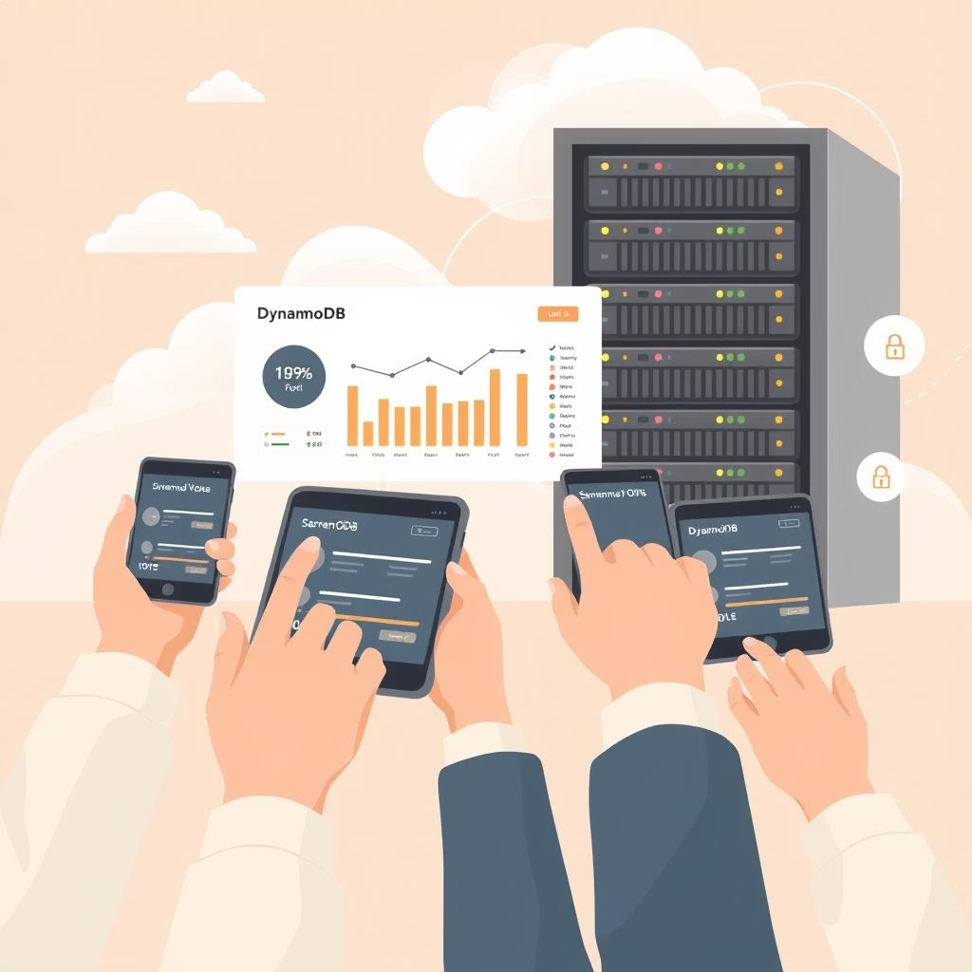
Project Goals
Real-Time Interactivity
Enable users to participate in live polls with instant updates across all connected clients using WebSockets.
Serverless Architecture
Use AWS Lambda for backend logic to reduce operational overhead.
Achieve scalability without managing servers.
Efficient Data Management
Store poll data and user connections using DynamoDB.
Ensure fast and highly available data access.
Minimal Infrastructure Management
Eliminate the need for traditional web servers by using API Gateway and Lambda.
Simplify deployment and scaling.
Seamless User Experience
Build a responsive frontend UI to display polls, accept votes, and show live results.
Scalable Frontend Hosting
Host the static site on Amazon S3 with global availability via S3 static website hosting.
Security and Best Practices
Use IAM roles for fine-grained permission control.
Ensure secure handling of WebSocket connections.

Slide 3

Advantages of Choosing This Project
✅ Serverless Expertise
Dive into AWS Lambda, API Gateway, and DynamoDB, which are core components of modern serverless development.
Practice building scalable apps without provisioning servers.
✅ Practical Use of DynamoDB
Learn how to design non-relational databases for speed and scale.
Gain experience with NoSQL data modeling, efficient queries, and real-time updates.
✅ Clean and Scalable Architecture
Understand how to separate concerns: frontend, backend, data store, and connection management.
Your architecture will be scalable, event-driven, and cost-effective.
✅ Full Stack Development Practice
You'll handle both frontend (HTML + JS) and backend (Lambda + DynamoDB), building complete ownership of the project.
Host the frontend on S3, making the app available globally.
✅ Great Resume Project
Shows skills in:
Serverless architecture
Real-time communication
AWS ecosystem (Lambda, API Gateway, DynamoDB, IAM, S3)
Scalable web app development
Demonstrates problem-solving with cloud-native tools.

Slide 4

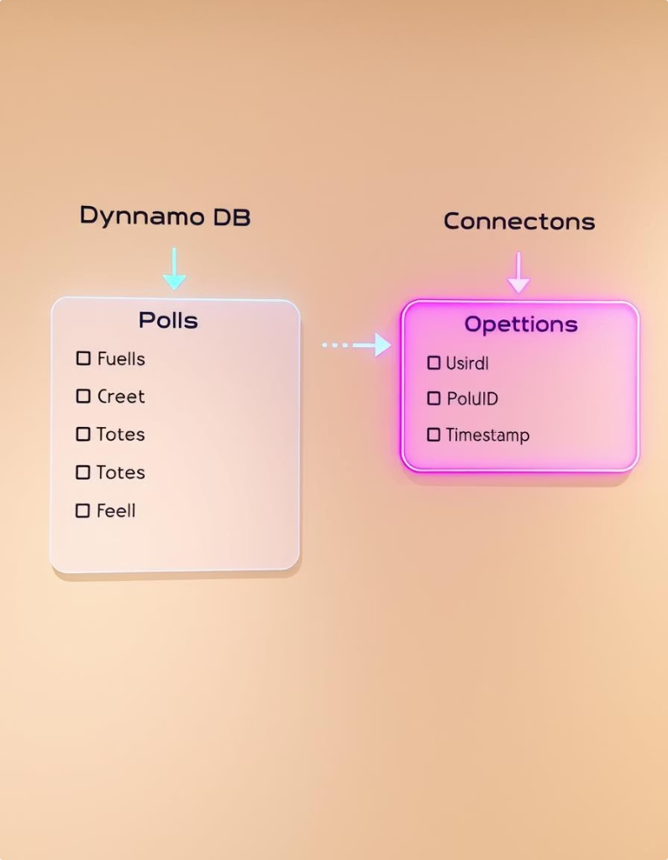
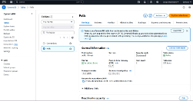
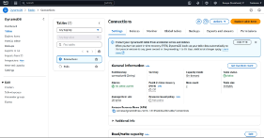
Step 1: Setup DynamoDB Tables
Polls Table
Stores poll questions and options with vote counts.
Primary key: pollId
Connections Table
Stores connected client IDs and watchers’ poll mapping.
Primary key: connectionId

Slide 5

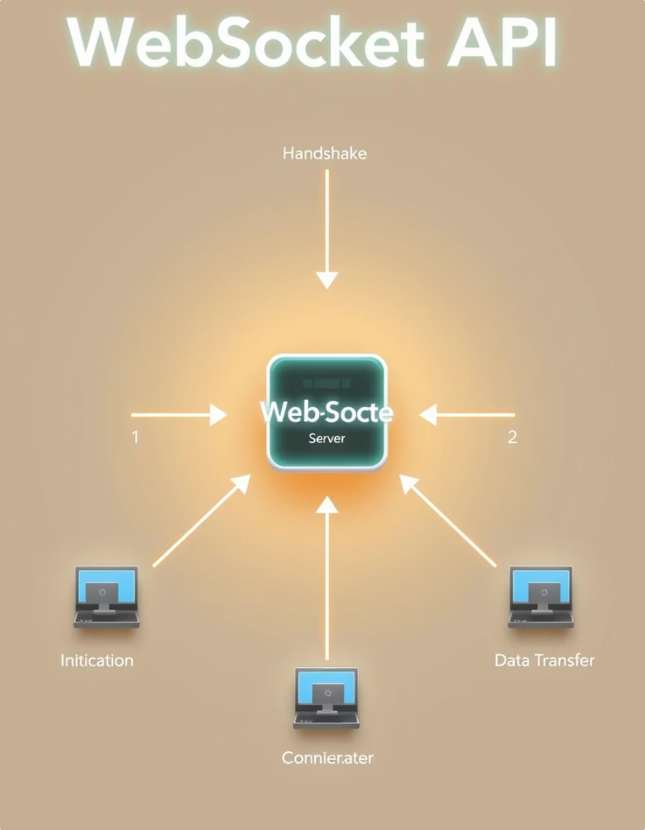

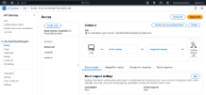

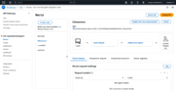

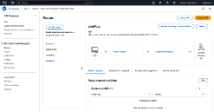
Step 2: Create WebSocket API in API Gateway
$connect
Triggered on user connection to create session.
$disconnect
Triggered when user leaves to clean up sessions.
sendVote
Custom route to handle vote submissions in real-time.

Slide 6

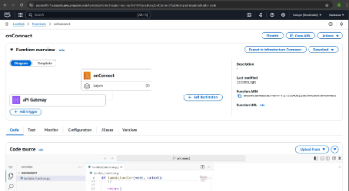
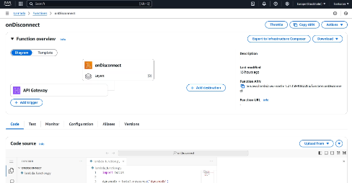
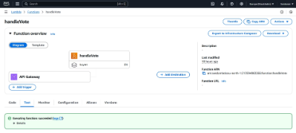
Step 3: Lambda Functions for WebSocket Events
1
onConnect
2
onDisconnect
3
handleVote
Adds connectionId to Connections table.
Removes connectionId to keep Connections clean.
Updates Polls with new votes and broadcasts results.

Slide 7
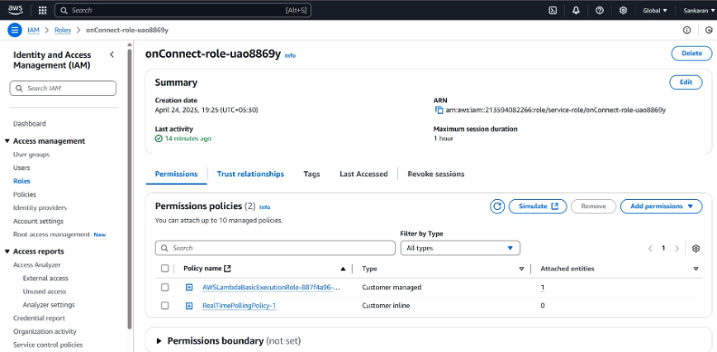
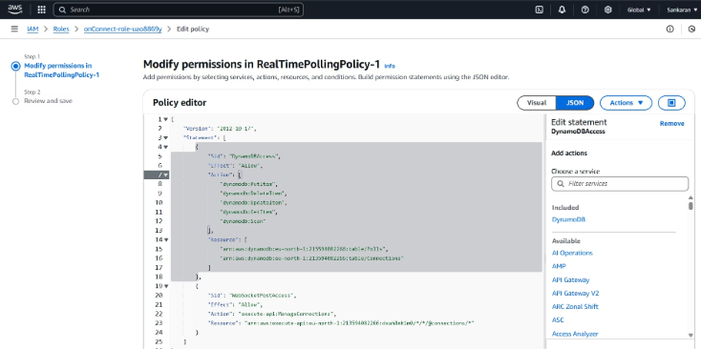
Step 4: Setup IAM Roles and Permissions
Lambda Permissions
Read/write access to DynamoDB tables
Publish messages via WebSocket API Gate

Slide 8
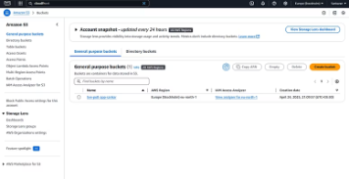
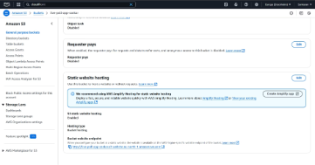
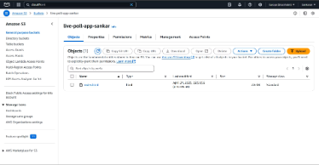
Step 5: Deploy Frontend with S3
S3 Setup
Access
Create S3 bucket
Use S3 URL to access the live polling frontend
http://live-poll-app-sankar.s3-website.eu-north-1.amazonaws.com
Enable static website hosting
Upload HTML and assets

Slide 9
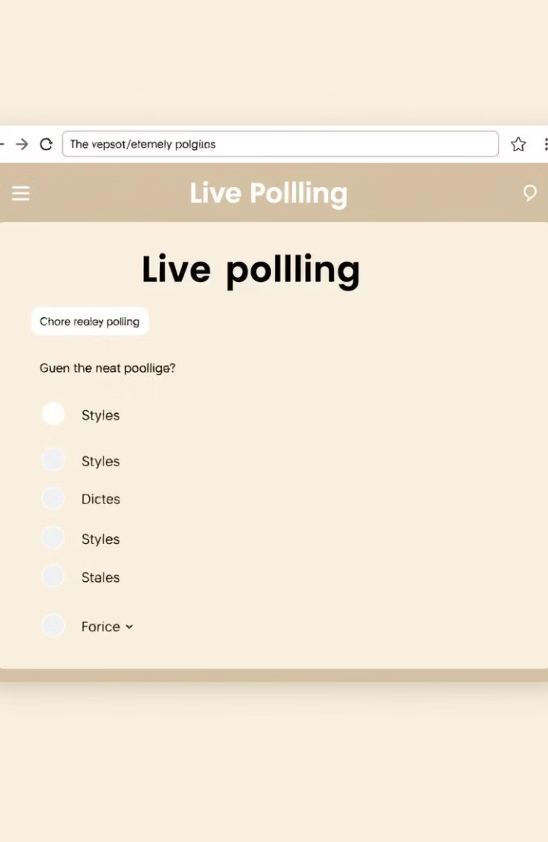
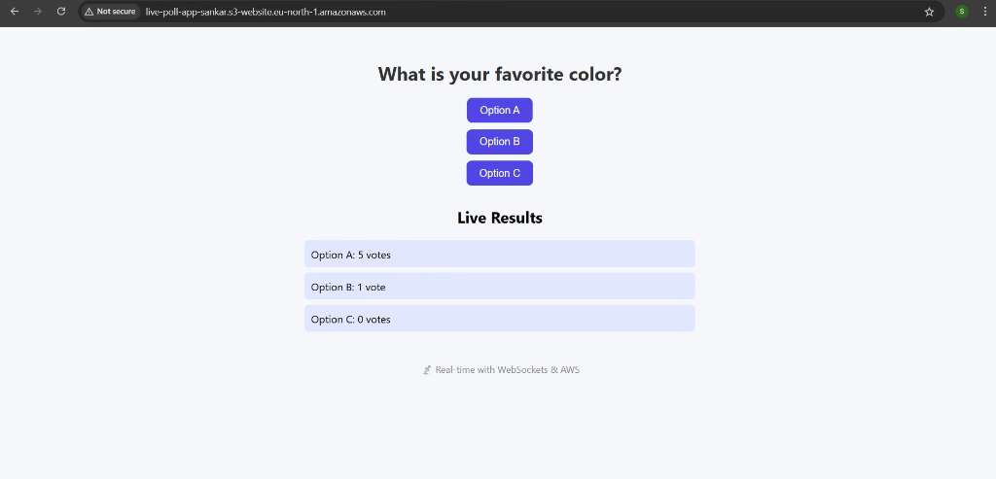



Step 6: Frontend Development
WebSocket Connection
Poll Display
Live Results
Show question and voting options
Update results instantly as votes arrive
Establish live connection to backend

Slide 10
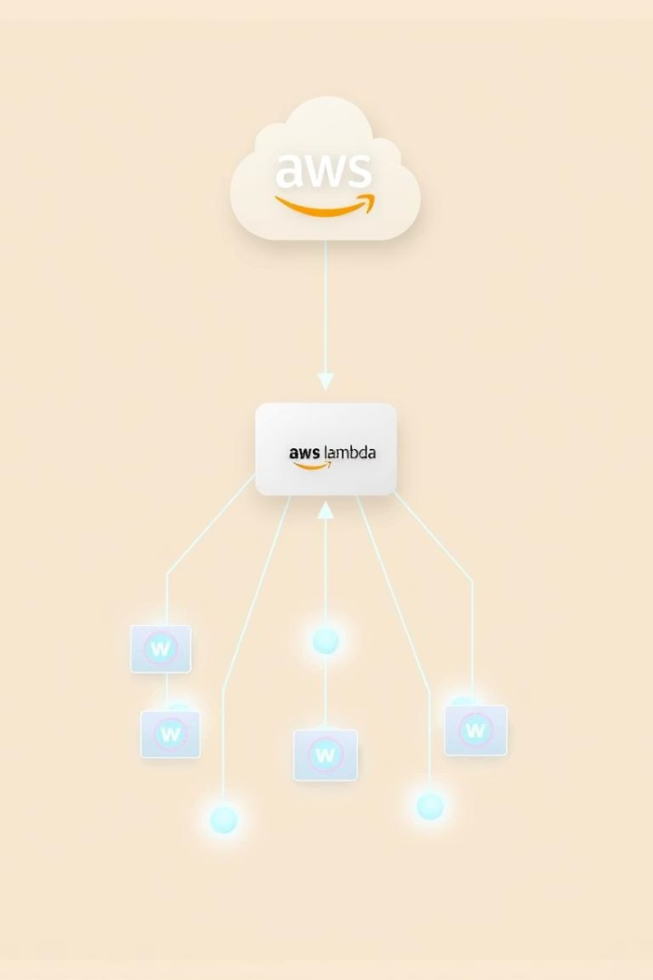
Step 7: Broadcast Updates to Clients
Vote Received
Lambda updates Polls table with new vote counts
Fetch Connections
Get all active client IDs from Connections table
Send Updates
Broadcast updated results via WebSocket API

Slide 11
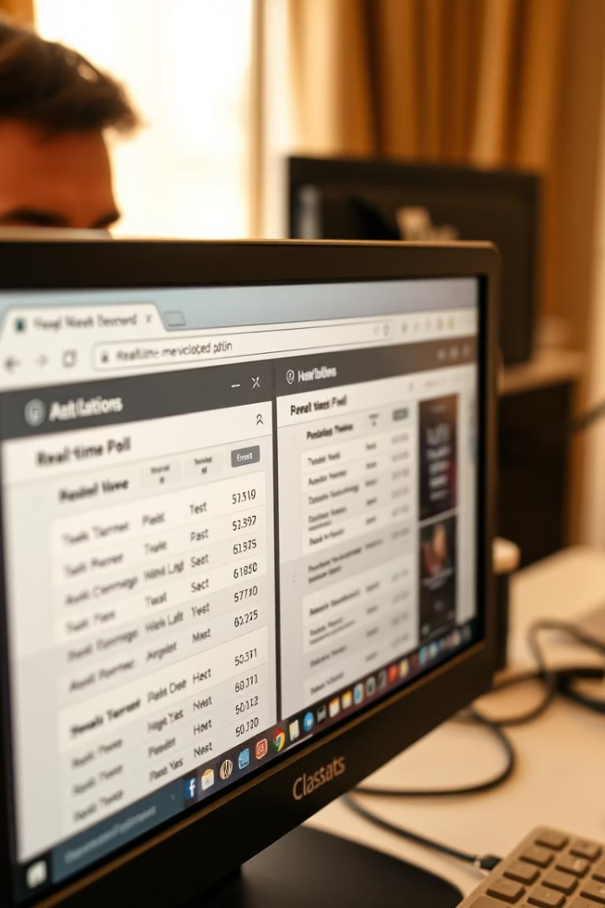
Step 8: Testing the App End-to-End
Open Multiple Tabs
Test Voting
Simulate different users connected simultaneously
Ensure votes update in real-time everywhere
Validate Disconnects
Verify connection cleanup on client leave

Slide 12
Optional Enhancements and Next Steps
Poll creation interface for admins
User authentication and session management
Export poll results for analysis
Visualize data with interactive charts
Automate deployments using CloudFormation or Terraform

Slide 13
Thanks To All
We appreciate your attention and engagement throughout this presentation.
Feel free to reach out for questions or further discussion on building real-time apps.
Questions?
Contact Us
Next Steps
We welcome your inquiries and feedback.
Reach out for support or collaboration opportunities.
Apply knowledge to your own projects and explore advanced features.

